Slide 1

Understanding Real & Fake Faces
DSP Project
Agniva Banerjee, Roll: 2410701
EECS Department (Ph.D.)
Hiba K T, Roll: 22146
DSE Department (BS-MS)

Slide 2

Content
Introduction
Dataset Overview
PCA & LDA Plot
Eigen Face Generation
Workflow
Dataset Augmentation
Feature Maps Collection
SHAP & LIME Explainer
Classification
Conclusion
Notes:
Write slide notes

Slide 3

Introduction
https://phys.org/news/2022-12-people-fake-susceptible-news-dire.html
Notes:
Write slide notes

Slide 4
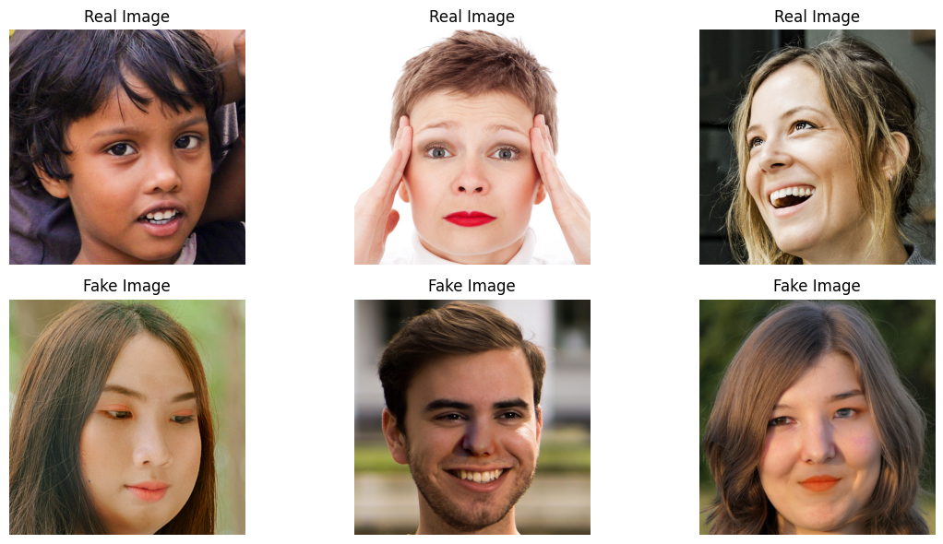
Dataset Overview
Contain two types of images: Real and fake
Fake Image Types: Easy, mid and hard
https://www.kaggle.com/datasets/ciplab/real-and-fake-face-detection
Notes:
Write slide notes

Slide 5
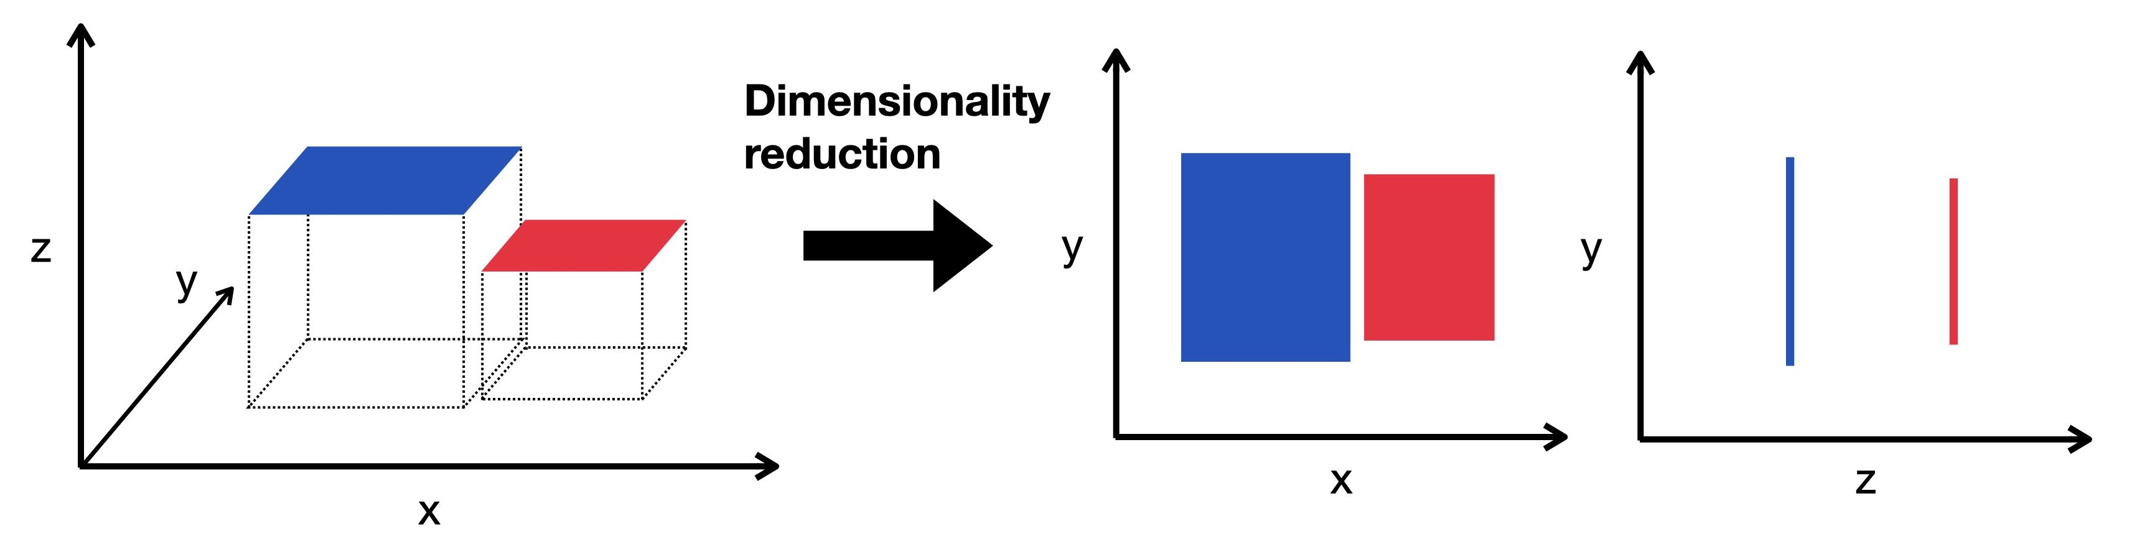
What would be the Solution!!!
What would be the Solution!!!
Dimensionality Reduction:
PCA (Principal Component Analysis)
LDA (Linear Discriminant Analysis)
Feature Extraction:
Use trained or pre-trained models to extract high-level features
https://www.sc-best-practices.org/_images/dimensionality_reduction.jpeg
Notes:
Write slide notes

Slide 6
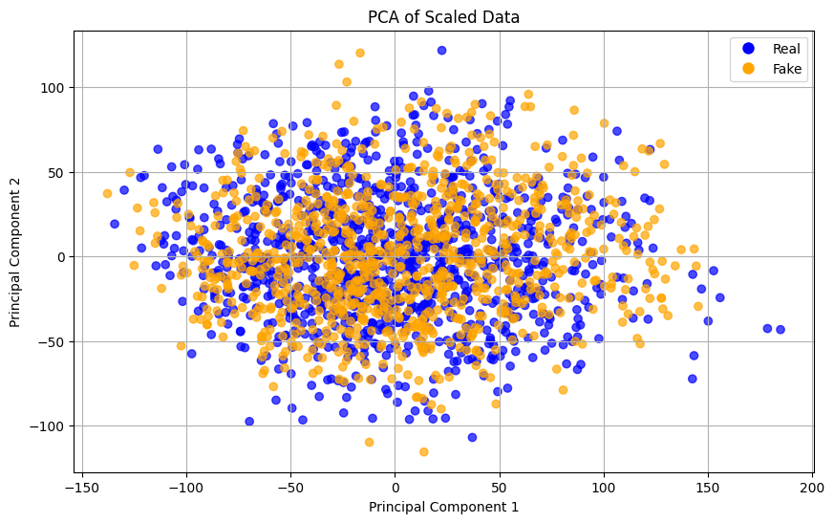
PCA
PCA, an unsupervised linear dimensionality reduction technique that helps us identify patterns in data based on the correlation between the features.
It aims to find maximum variance in high dimensional data and project it into a lower dimensional feature space.
Steps
Standardize data
Compute covariance Matrix
Compute and sort eigenvalues
and eigenvectors
Select principal components
Transform data according to
components
Notes:
Write slide notes

Slide 7
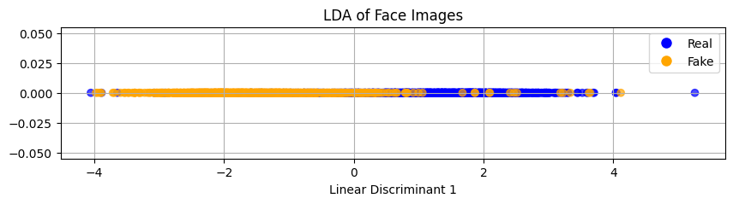
LDA
LDA is a supervised linear dimensionality reduction technique to find the feature subspace that optimizes class separability.
Steps
Standardize data
Calculate class means & overall mean
Compute scatter matrix within-class (SW) & between-class (BW)
Compute and sort eigenvalues & eigenvectors
Select principal components
Transform data according to components
Notes:
Write slide notes

Slide 8
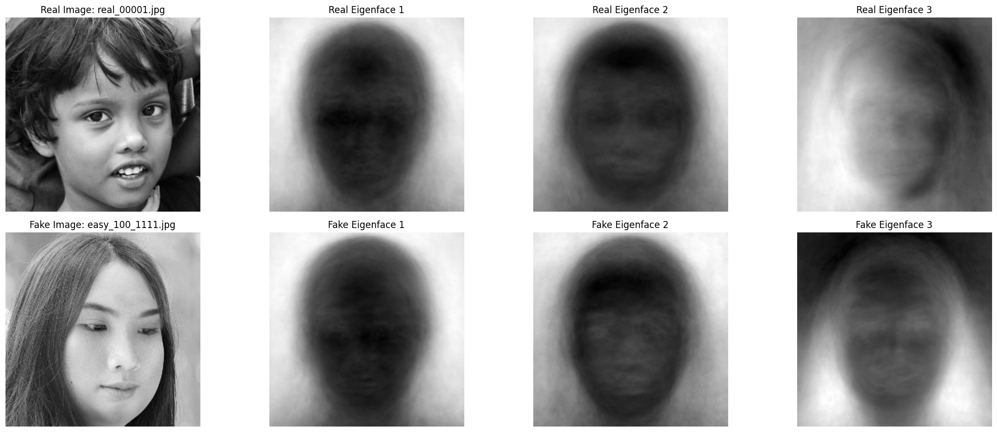
Eigen Face
Set of eigenvectors used in facial recognition systems to represent human faces
Derived from PCA
Allow for efficient comparison and recognition
Notes:
Write slide notes

Slide 9
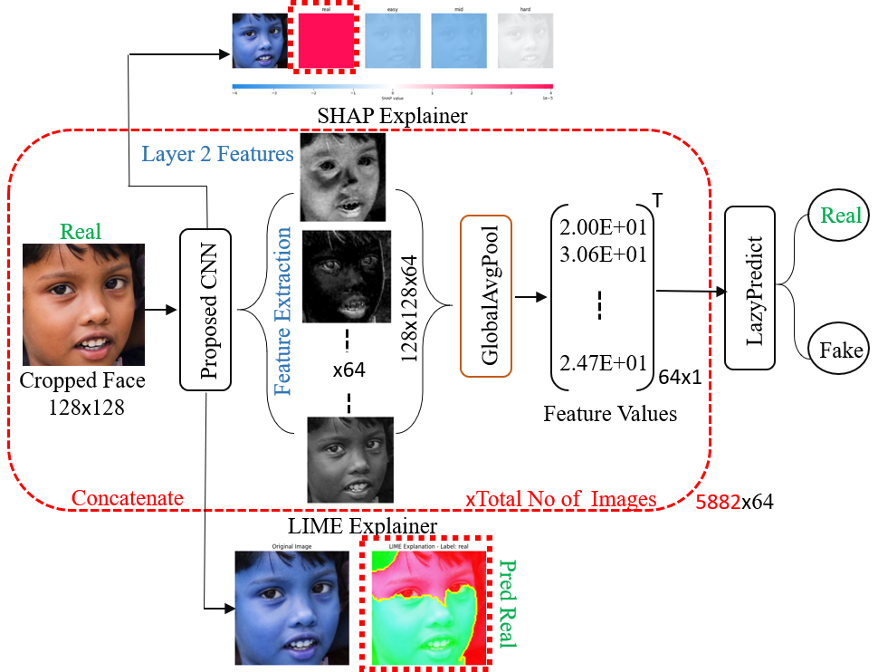
Workflow

Slide 10
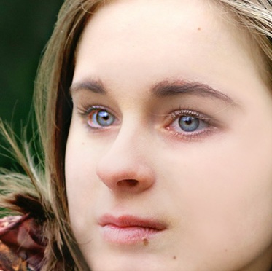
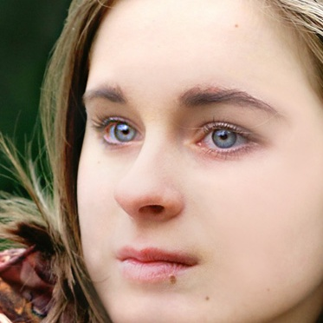
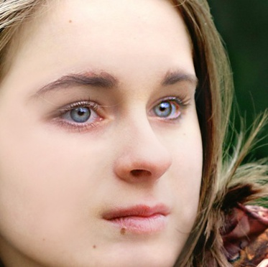
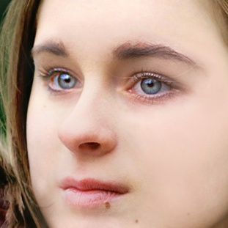
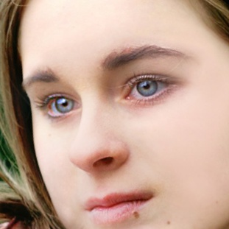
Dataset Augmentation
Width Shift
Large dataset necessary to train CNN model
Face are cropped before applying augmentation on each fake image
Four different augmentations applied
Cropped Face
Face Shifter
Height Shift
Rotation
Notes:
Write slide notes

Slide 11
1: initialize model as Sequential
2: for filters in {32, 64, 128}:
3: add Conv2D layer with filters, (3, 3), relu
4: add MaxPooling2D layer with (2, 2)
5: end for
6: add Flatten layer
7: add Dense layer with 128 units, relu
8: add Dense layer with 4 units, softmax
9: compile the model using ’adam’, ’accuracy’ and ’categorical_crossentropy’
10: fit model for 100 epochs and 32 batch size
11: evaluate model on test data
12: save model
Proposed CNN Model

Slide 12
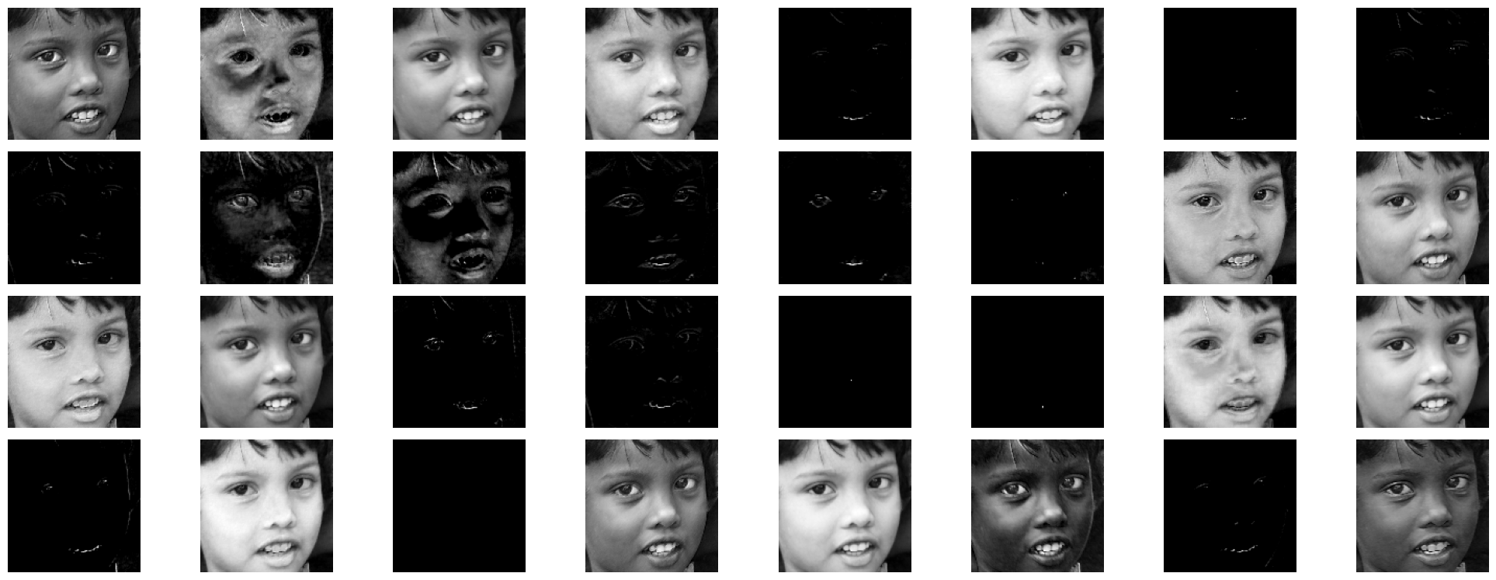
Feature Maps
Collected from the second convolution layer of the proposed CNN model
A total of 64 feature maps are obtained

Slide 13
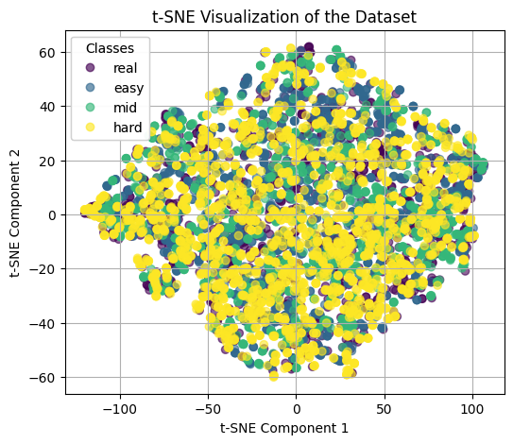
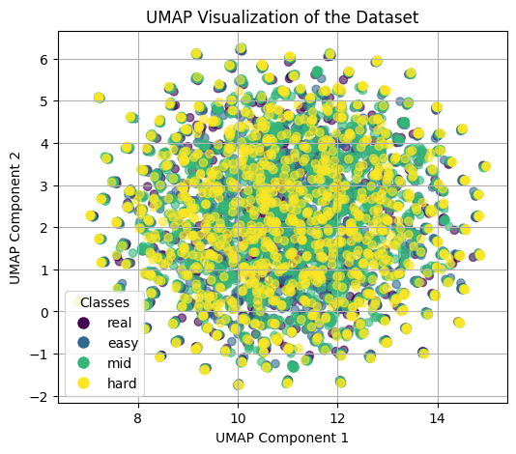
T-SNE & UMAP
A t-distributed Stochastic Neighbor Embedding (t-SNE) plot for computing the similarity between each data point and all other points in the dataset
A uniform manifold approximation and projection (UMAP) emphasizes the distinction between real and fake images at different levels of visibility
Both the plot generated after obtaining the 64 feature value of each images

Slide 14
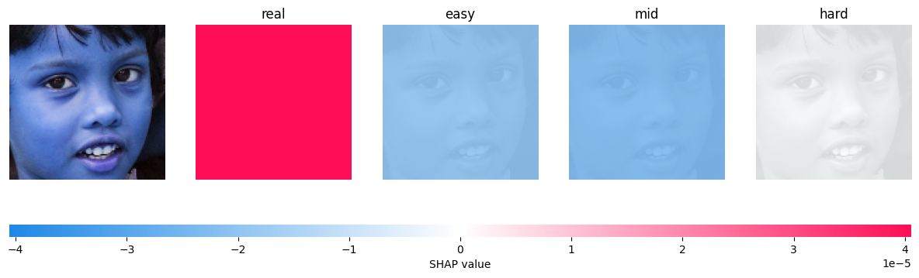
SHAP Explainer
SHAP is an effective tool that expounds AI model predictions
Demonstration provides SHAP explanations for deciding face authenticity
Exhibiting a variety of model confidence for each prediction (real, easy, mid, hard)
The SHAP values represent feature contributions for identifying each of the classes

Slide 15
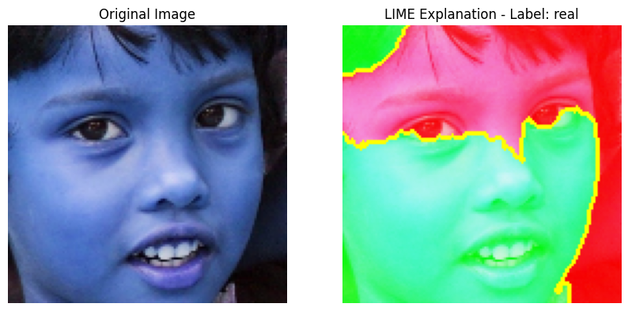
LIME Explainer
Elucidates the extent to which individual features influence a particular image by the model’s predictions
Interprets the model’s thinking by perturbing segments of the image and analyzing the resultant changes in predictions
Identifying regions that significantly affect the model’s
Segmenting an image into features

Slide 16
Classification Using LazyPredict
Streamlines benchmarking by automatically training and assessing various classifiers
Facilitating rapid assessment without considerable optimization
Employs ExtraTrees, RandomForest, LabelPropagation, LabelSpreading, and XGBoost to identify the optimal model for differentiating between real and fake images
Model | Accuracy | Balanced Accuracy | F1 Score
ExtraTreesClassifier | 0.91 | 0.89 | 0.91
RandomForestClassifier | 0.90 | 0.88 | 0.90
LabelPropagation | 0.90 | 0.88 | 0.90
LabelSpreading | 0.90 | 0.88 | 0.90
XGBClassifier | 0.89 | 0.87 | 0.89

Slide 17
Conclusion
Represents the potency of amalgamating feature maps with explainable AI algorithms.
The application of SHAP and LIME enhances the model’s robustness and reliability
This approach identifies critical visual patterns by examining feature maps, elucidating their impact on both accurate and inaccurate classifications
Please visit for code:
https://github.com/agniva22/DSP_Project
Thank you
?

